Slide 1

Salary Management in the NFL
Jarrett Markman

Slide 2
Methodology
Every single professional sport has a finite amount of money given dedicated to paying salaries to their players. In the NFL, there are many teams that have a variety of different strategies in forming their teams based on salaries. It’s very common for teams to invest a lot of money in a position like quarterback, however, for some teams the quarterback can cost upwards of 20% of the team's cap space. Many teams find a lot of success with quarterbacks on rookie contracts, such as the 2021-2022 Cincinnati Bengals. Is there a way that teams should effectively use their allotted cap space? Does more spending lead to more success in the NFL? Is there a way to convey how teams should use their cap space in today’s NFL?

Slide 3
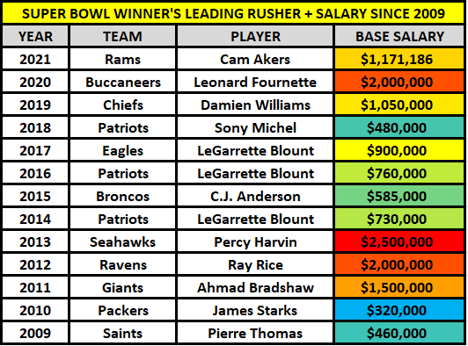
https://twitter.com/marcus_mosher/status/1493067757138628609?s=10

Slide 4
Team Salary Evaluation
2019, 2020, 2021 Seasons
Data found from spotrac.com and overthecap.com
Used Total Cap $ for all cap allocations in that year
Used win % and draft pick position as a measurement of success
Regression models and correlation coefficients

Slide 5
2019

Slide 6
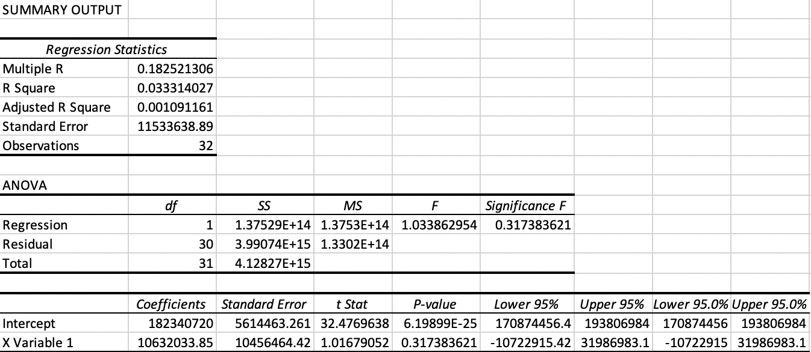
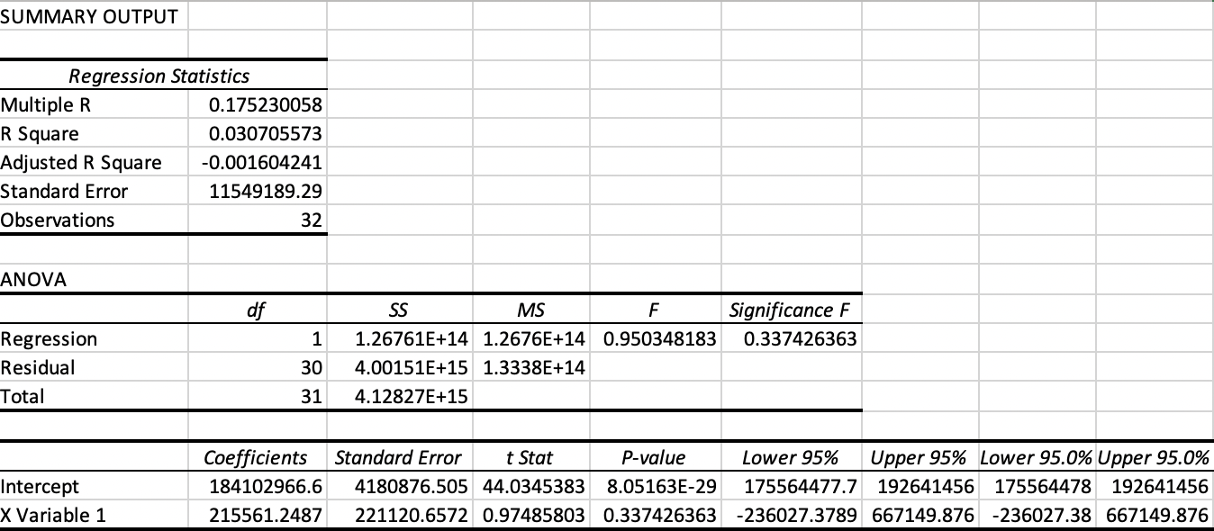
2019 Total Cap – Win % Regression
2019 Total Cap – Draft Pick Position Regression

Slide 7
2020

Slide 8
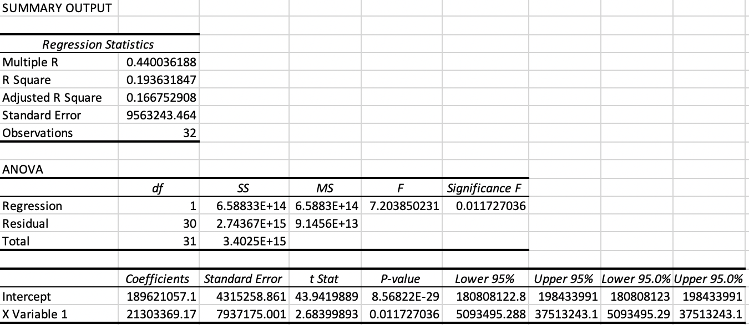
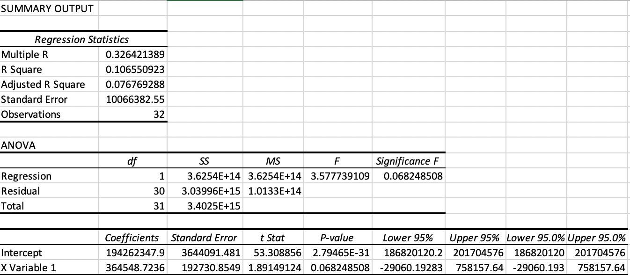
2020 Total Cap – Win % Regression
2020 Total Cap – Draft Pick Position Regression

Slide 9
2021

Slide 10
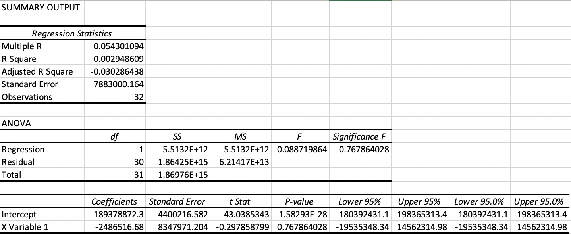
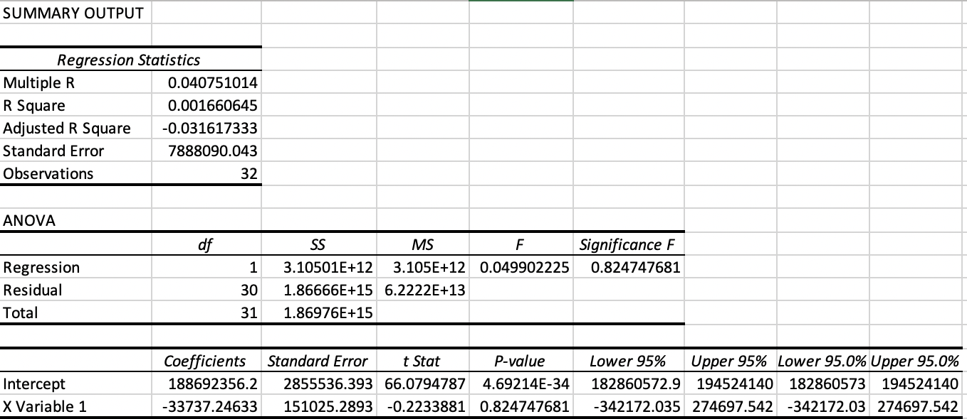
2021 Total Cap – Win % Regression
2021 Total Cap – Draft Pick Position Regression

Slide 11
Analysis
In 2019 there were R correlation coefficients of ~ .18 for both Total Cap to (win% and draft pick position).
In 2020 there were R correlation coefficients of ~ .44 and .33 for Total Cap to (win % and draft pick position).
In 2021 there were R correlation coefficients of ~ .05 and .04 for Total Cap to (win % and draft pick position).
For team salaries, I think it’s fair to say that it’s inconclusive if team spending is related to success or not. In 2019 and 2021 there was no correlation between total cap and win % and total cap and draft pick position. However, it 2020, there was a small positive correlation between total cap and win% and total cap and draft pick position.
I would say that because the data proves no strong positive correlation between either win % or draft pick position and total cap, it doesn’t make much sense for NFL teams to be under the belief that more spending leads to more success.
In my opinion, I believe that teams should approach NFL spending more efficiently, and just aimlessly throwing money at certain players when the team isn’t currently competitive is a poor strategy for team building.

Slide 12
Sources
https://scholarworks.calstate.edu/downloads/z603qz23h?locale=en
https://bleacherreport.com/articles/1665623-how-does-the-salary-cap-work-in-the-nfl
https://www.nfl.com/news/nfl-informs-clubs-2022-salary-cap-projected-to-be-208-2-million
https://overthecap.com/
https://overthecap.com/salary-cap-space/
https://www.tankathon.com/nfl
https://www.spotrac.com/nfl/cap/2021/
https://www.spotrac.com/nfl/cap/2020/
https://www.spotrac.com/nfl/cap/2019/
https://www.nfl.com/news/2021-nfl-draft-order-for-all-seven-rounds
https://sports.nbcsports.com/2020/04/25/nfl-draft-order-2020/
https://www.graduatetutor.com/statistics-tutor/interpreting-regression-output/#:~:text=Statistically%20speaking%2C%20the%20significance%20F,regression%20output%20are%20actually%20zero!

